Slide 1
Aerospace Launch Business Analytics Lifecycle
Jibri Tolen & Gael Ruta, Aerospace Project Engineering Intern
Technical Focus Matrix Block(s):
Notes:
Hello and good afternoon everyone. I am {Say Name}. I will be talking to you today regarding Aerospace Launch Business Analytics Lifecycle.

Slide 2

Objective:
Our objective is to provide the EAC Spaceport Feasibility Study team with insight into launch business. Based on past data and current trends to better predict the future of the industry using statical analysis.
Notes:
{ Read the Objective } => In our case, we wanted to search recursively for commonalities between the data set of launch statics by cross referencing different DBs. What we were specifically looking for was how much of a variance of a standard day would be most optimal for mission success by reviewing pass launch failures and successes.

Slide 3
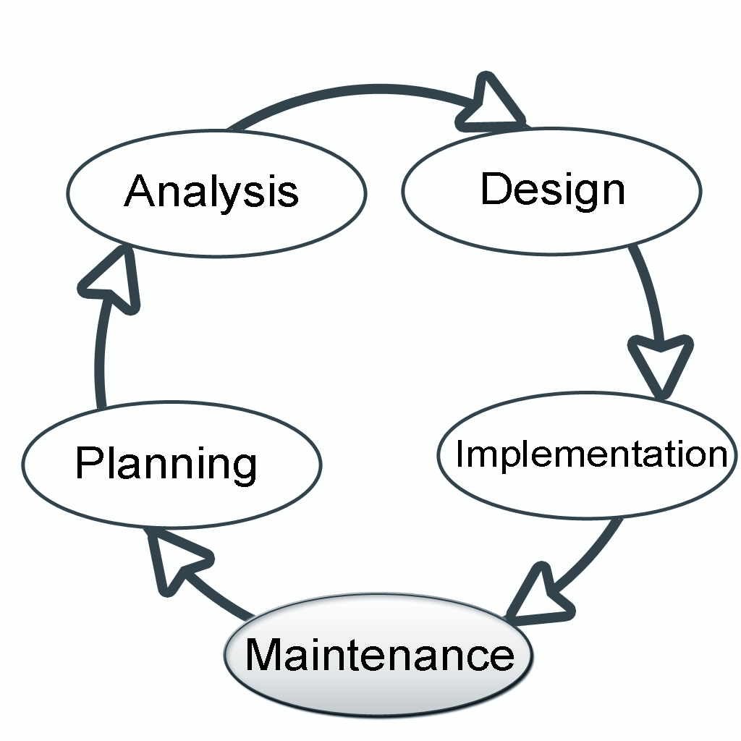
Where to start?
Notes:
If I had only one hour to save the world I would spend fifty five mins defining the problem and only five mins thinking of the solution. (~ Albert Einsine) I like this quote because the ability to plan is the key to success. For us aspiring Software Engineers, were taught this level of thinking is referred to as the Software Development Life Cycle. We Broke our project into 5 basic phases.
Phase I the most important phase planning here we answer the 5 Ws Who, What, When, Where, and Why. We also reviewed what tools we may need meaning platforms, programing languages, environments, and last but certainly not least we needed to choose a DB whether relational or non relational. Once our problem was defined, It was safe to say we could now move to
Phase 2 the analysis. In this phase we need to put the pieces together then develop a brute force approach then desk check our plan. That means walk through the entire life cycle and think through any thing that could possibly go wrong or right. As master yoda would say become one with the system. (ha ha)
Phase 3 the design phase led us to optimization, how can we make this process as seamless as possible in addition, can we develop it to run within a specified time complexity with all its moving parts? As most other software engineers are thinking right about now, yes BigO came walking in the room again. (ha ha)
Phase 4 the implementation,this is where we really get our hands dirty implementing the lifecycle into deployment.
Finally, Phase 5 Maintenance, this is where we focused heavy on User Access. Creating Groups to insure the integrity of the data.

Slide 4

Phase 1 : Planning
Notes:
Our goal was to establish commonalities between the data set. First thing on our list what are our needs ? During the database selection process we took into account that a portion of the research will integrate a ML algorithm for a larger mission that may outgrow the scope of our current function. In addition, we quickly realized the data needed a central location for all Create Red Update and Delete (CRUD) processes to be seen by all members on our team at any given time.

Slide 5
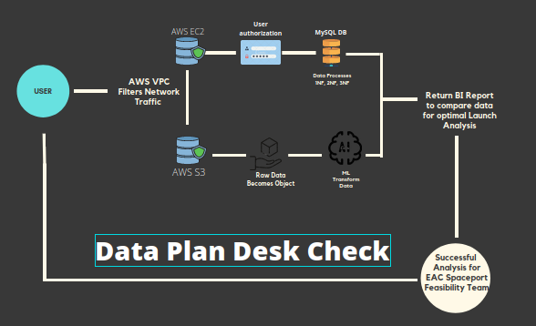
Phase 2: Analysis
Notes:
The analysis of our goal posed several different contingencies in our plan that could possibly compromise the integrity of the data. In addition, since we were using the data to Query reports both in and outside the scope of our mission. We knew the data needed to be handled differently. Our last possible point of failure were network security and user authentication defined by User Groups and Permissions. We were able to develop a solid plan to work through our issues. We leveraged AWS since most of the services we needed that had them all in one place. AWS VPC was our first line of defense for our Servers. EC2 and S3 were the services most optimal for this project. Once the user request to SSH into the servers from a whitelisted IP address they would then login using the credentials they we provided them upon creation of the Server and User Groups. Depending on there permissions they will be able to manipulate the data using DDL or DML queries. That data will then be exported from the DB to a .csv file for further use. The S3 instance will convert the raw data to an object to be further manipulated by our ML Algorithm. The results will also be returned via a .csv file.

Slide 6
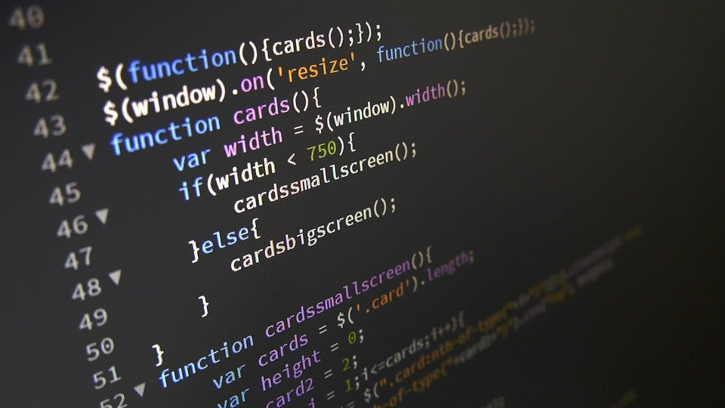
Phase 3: Design
Notes:
Optimization came into play reviewing the data sets as they shall be used. Implementing a ML algorithm in a Data Warehouse the has been normalized outside of the scope of its request creates additional latency. This could cause an even greater issue as the data increase so does the latency taking us further away from O(n) possibly leading to O(n^2) or even worse O(n^3). Therefore we left the data raw as an object to maintain efficient time complexity.

Slide 7

Phase 4: Implementation
Notes:
Here is where all the fun begins. From developing automation scripts in both python and java to normalize the dataset for us. To building, deploying, and managing AWS Instances, Security Groups, AWS VPC, and User Access

Slide 8
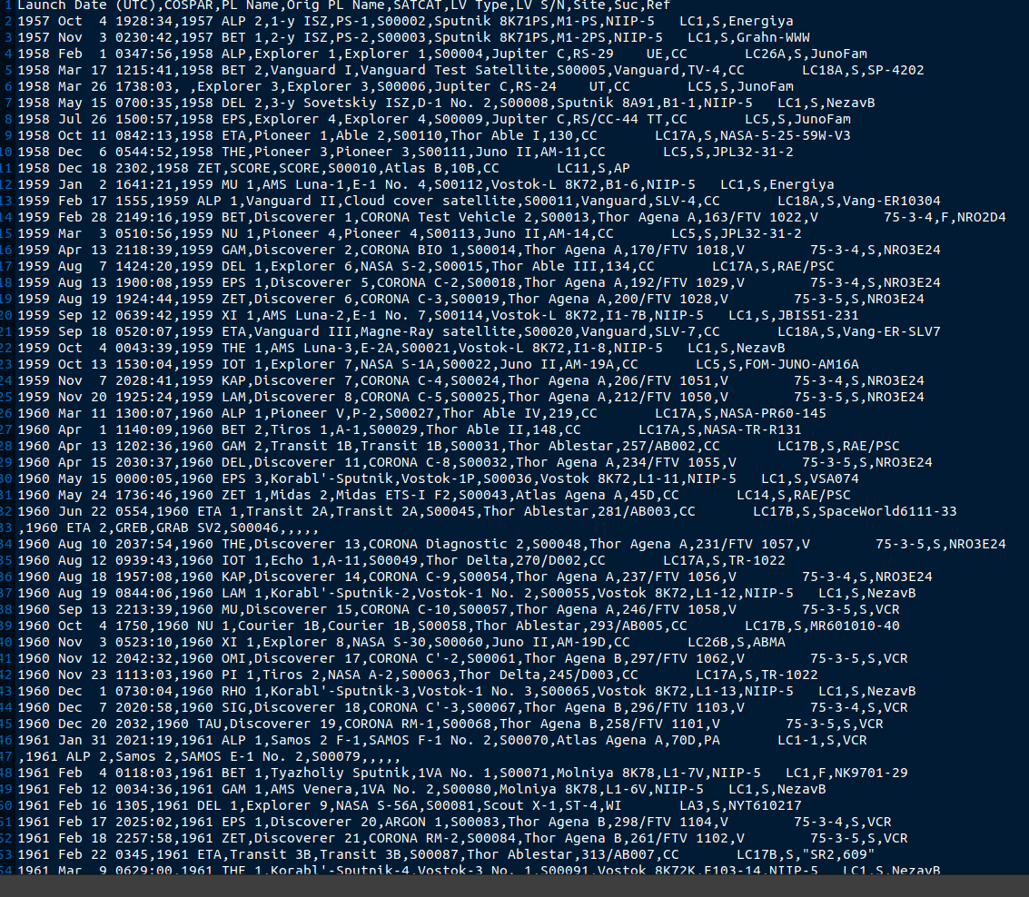
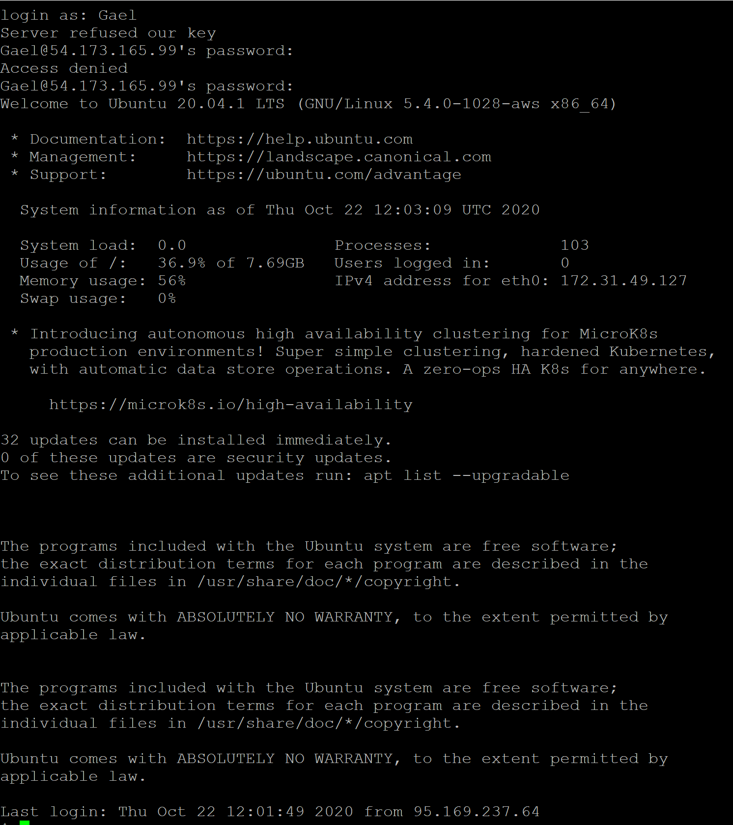
Phase 5: Maintenance
Notes:
The Maintenance phase of our project is just as equally important as the planning phase. It is one thing to view a project theoretically, it is another to view this project practically. The reason for this is that in a development environment There are things that can be overlooked or mis represented. It is always good to review the work that was done to test for efficiency. Here shows two examples of issues that arose during the maintenance phase that needed to be corrected. One of the Users was not able to SSH into the Server and one he was he was not able to see the DB that was created under his account. On the left this is a picture of the raw data that was passed using some invalid characters. This was caught in a try catch block and throw a few different exceptions. Both issues were rectified successfully.

Slide 9
Conclusion
Through implementing the five phases of our data life cycle. We were able to successfully plan, organize, develop, and deploy the service to the Feasibility Team. Where the data will assist in the implementation of a future Spaceport.

